Slide 1
Confusion Metrix
Aniket patil

Slide 2
Confusion matrix
Confusion matrix is used to compare predicted and actual values.
A much better way to evaluate the performance of the classifier is to look at the confusion matrix.

Slide 3
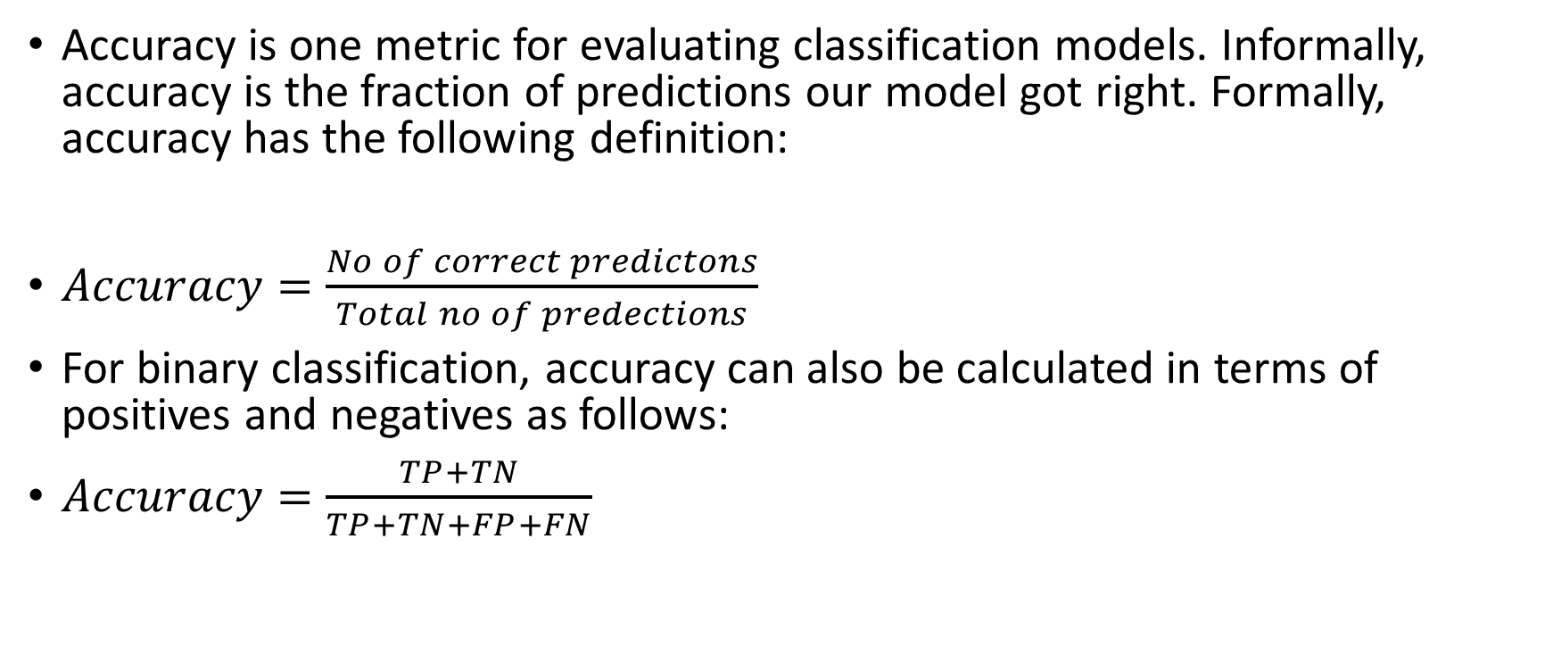
Accuracy
Accuracy is one metric for evaluating classification models. Informally, accuracy is the fraction of predictions our model got right. Formally, accuracy has the following definition:
$Accuracy=\frac{No of correct predictons}{Total no of predections}$
For binary classification, accuracy can also be calculated in terms of positives and negatives as follows:
$Accuracy=\frac{TP+TN}{TP+TN+FP+FN}$

Slide 4
True class
Positive Negative
Negative Positive
TP (True Positive) | FP (False Positive)
FN (False Negative) | TN (True Negative)
Predicted class

Slide 5
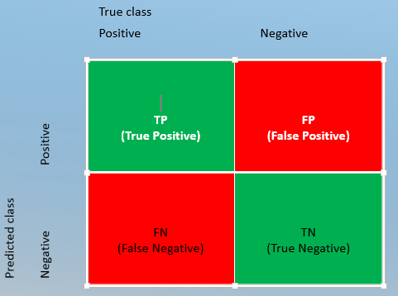
True Positive: Actual Positive and Predicted as Positive
True Negative: Actual Negative and Predicted as Negative
False Positive(Type I Error): Actual Negative but predicted as Positive
False Negative(Type II Error): Actual Positive but predicted as Negative

Slide 6
Examples
True Positive(TP)
Patient with covid is told that he/she has covid.
True Negative(TN)
Patient with no covid is told that he/she has no covid.
False Positive(FP)
Patient with no covid is told that he/she has covid.
False Negative(FN)
Patient with covid is told that he/she has no covid.

